Slide 1
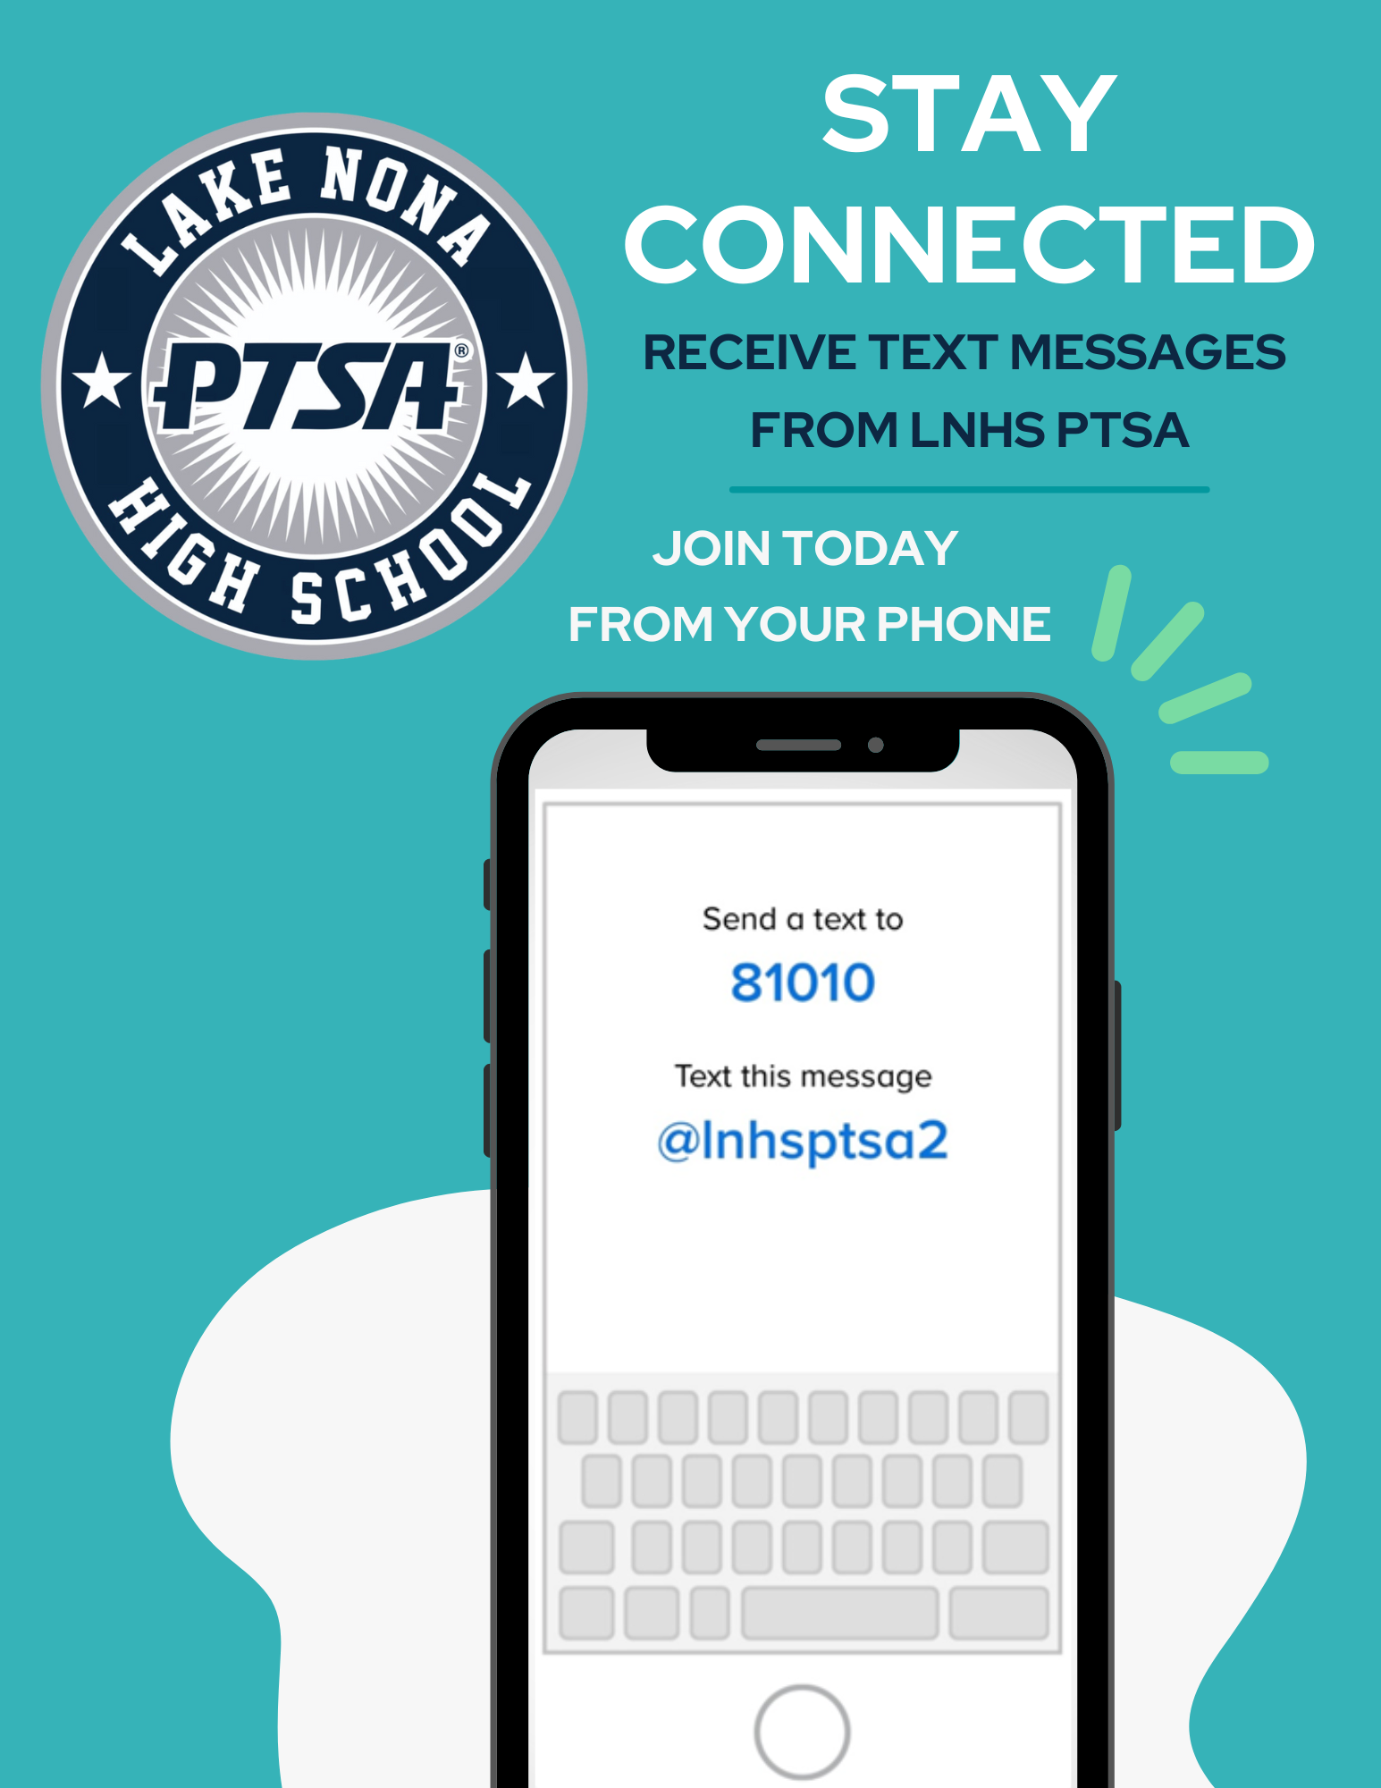


WELCOME
LNHS PTSA
GENERAL MEETING
WEDNESDAY
JANUARY 21, 2026
MEDIA CENTER
81010
@ptsalnhs
www.LNHSPTSA.com

Slide 2
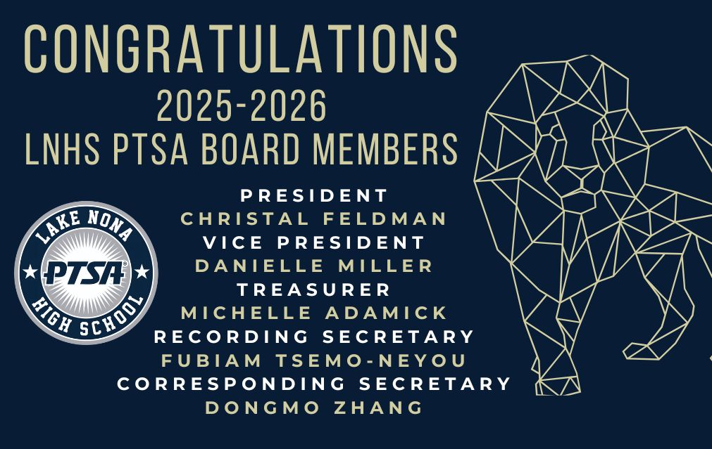

Slide 3

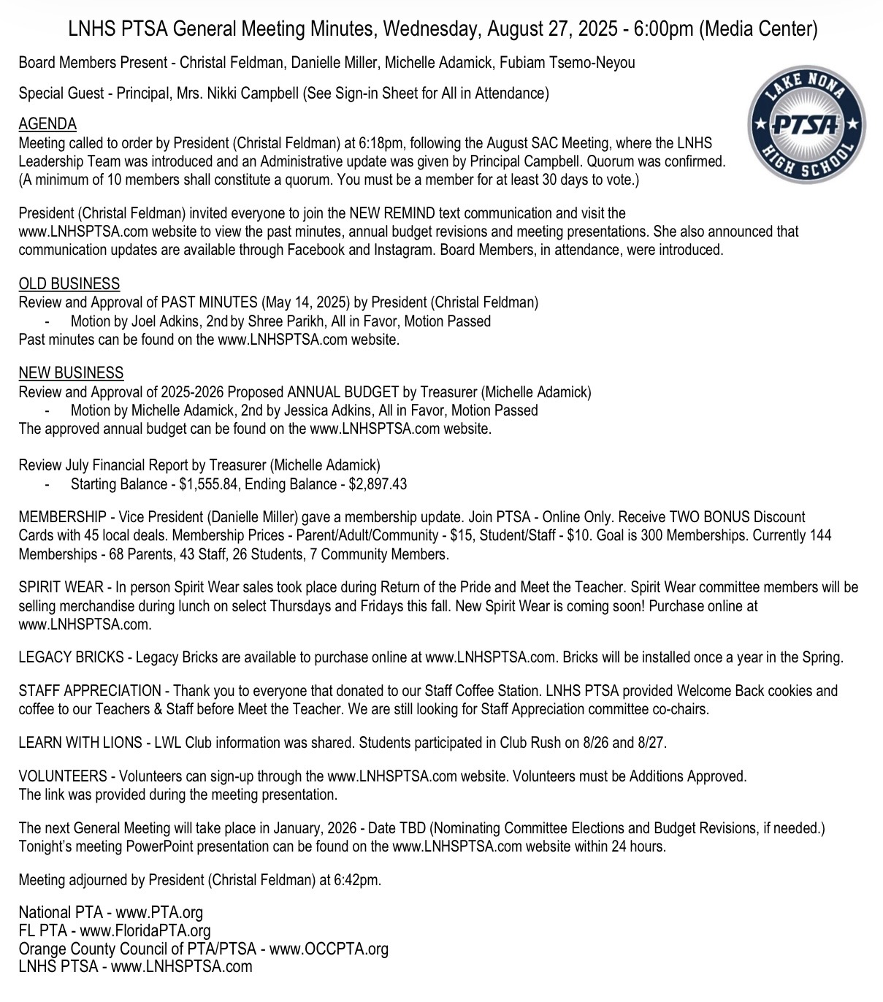
PAST MINUTES
AUGUST 27, 2025
FOR APPROVAL

Slide 4
DECEMBER 2025
FINANCIAL
REPORT
Starting Balance - $4,021.66
Ending Balance - $3,211.03

Slide 5
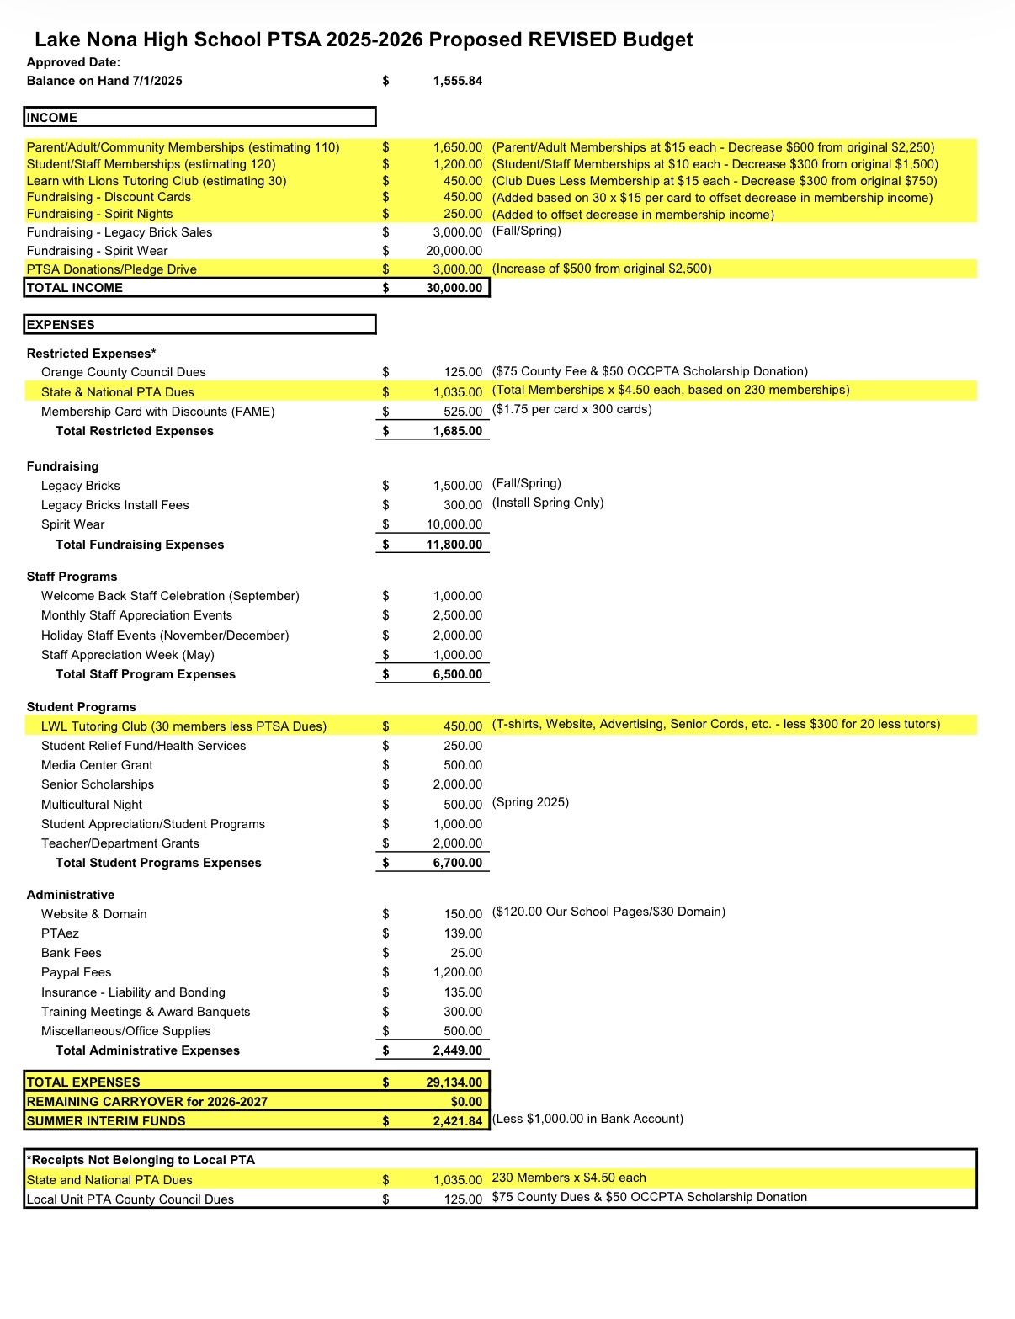
PROPOSED REVISED
ANNUAL BUDGET
FOR APPROVAL

Slide 6
NOMINATING COMMITTEE ELECTIONS

Slide 7

Help Us
Meet Our Goal
of 300 Memberships!
Parents - 94
Staff - 60
Students - 55
Community - 10
219
Memberships

Slide 8



NEW SPIRIT WEAR COMING SOON!

Slide 9



Slide 10

LEGACY
BRICKS
- Now Available to
Purchase Online
- Install Once a Year
in the Spring

Slide 11
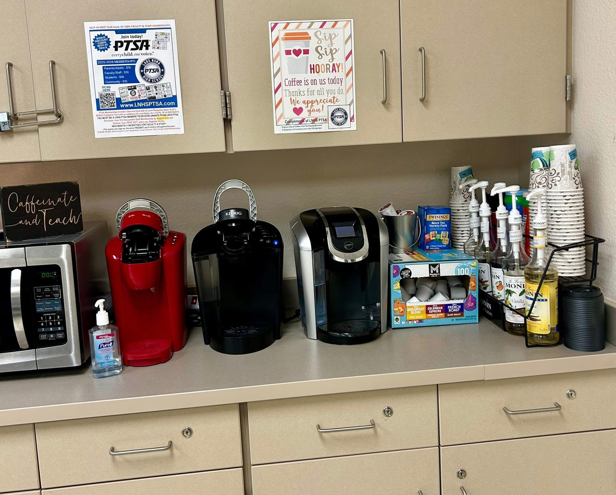
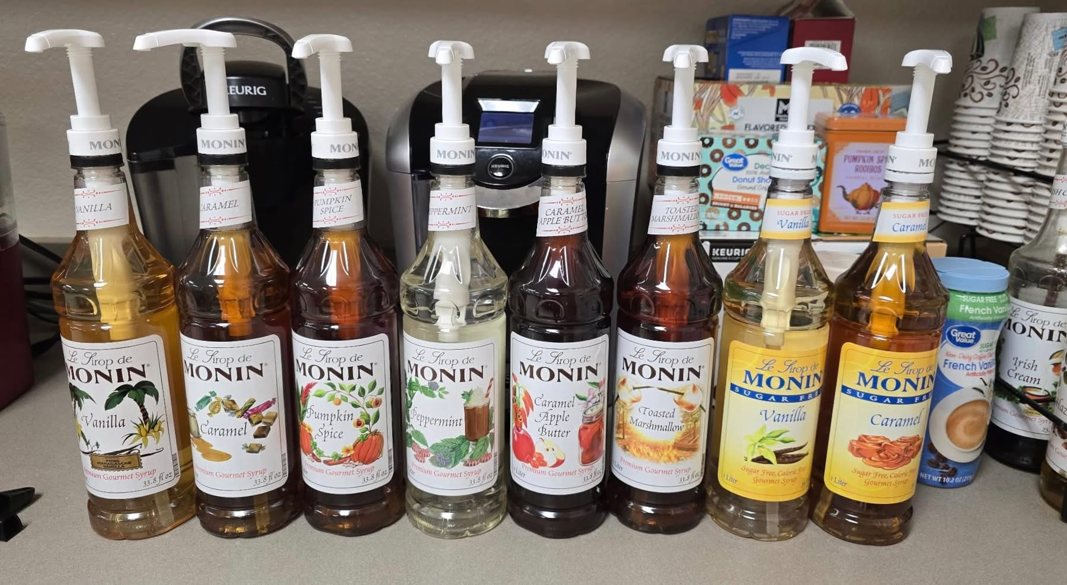
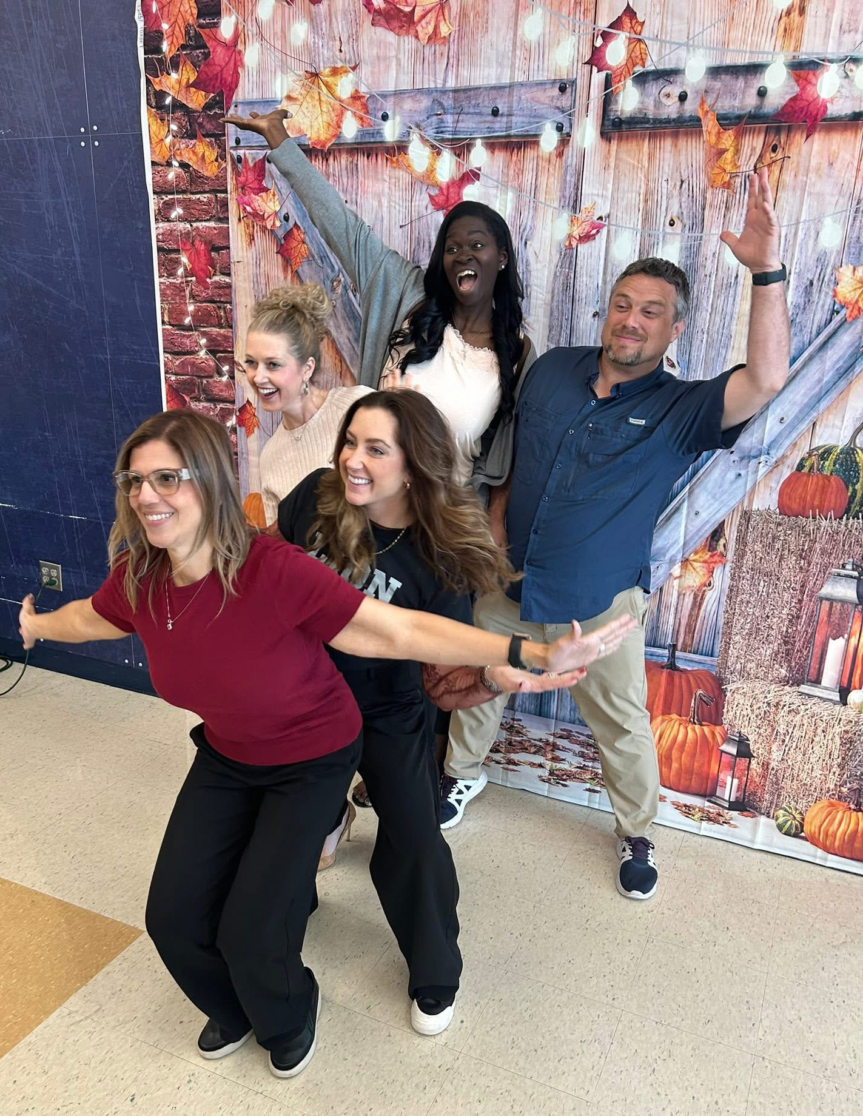

STAFF
APPRECIATION
Co-Chairs Needed
Thank You
Community Sponsors
Teacher/Department Grants

Slide 12

LEARN WITH
LIONS
Virtual Tutoring Club

Slide 13

SENIOR SCHOLARSHIPS

Slide 14


Slide 15


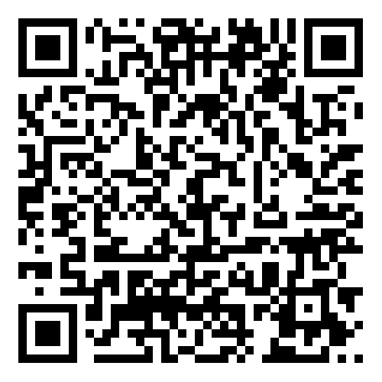

EMAIL - LNHSPTSA@gmail.com
WEBSITE - www.LNHSPTSA.com
Next Meeting - April/May TBD

